Slide 1
To Breathe or not to Breathe…
The Asthmatic’s Struggle
Nicole J. Wagner, BSN, RN-BC
Alverno College
Spring 2012
MSN 621

Slide 2
Navigating the Tutorial
Click this arrow in the bottom right hand corner to go to the next slide.
Click this arrow in the bottom right hand corner to go back to the previous slide.
Throughout the tutorial there will be questions to assess your comprehension of the material. Possible answers will be listed in these circles and you will click on the circle with the answer you believe is correct to receive feedback. The feedback will slowly disappear, allowing you to answer again if you wish.

Slide 3
Outcomes
By the end of this tutorial, the learner will…
  Be able to define asthma
  Verbalize the inflammatory response that takes place during an asthma attack
  Identify common clinical manifestations of an asthma exacerbation

Slide 4
The Ins and Outs of Asthma
In America, 18.7 million adults and 7.0 million children are currently living with a diagnosis of asthma (1,2)
Asthma is a chronic inflammatory disorder of the airways, characterized by recurring episodes of airway obstruction
Asthma can be classified as either extrinsic or intrinsic
  Extrinsic: an antigen or allergen, such as dust mites or animal dander, causes a hypersensitivity reaction
  Intrinsic: reactions are triggered by many things such as respiratory tract infections, inhalation of chemicals/pollutants, cold air, exercise, reflux, etc. (3)

Slide 5
Case Study
Nathan is a 10-year old boy with extrinsic asthma. He was over at his grandma’s house for Thanksgiving and was playing with Smokie, his grandma’s cat. About 15 minutes after arriving at his grandma’s house, Nathan ran to his mom because he wasn’t feeling well. His respiratory rate was elevated at 34 breaths per minute, and he began to cough, had audible wheezing, and was clearly suffering from dyspnea.

Slide 6
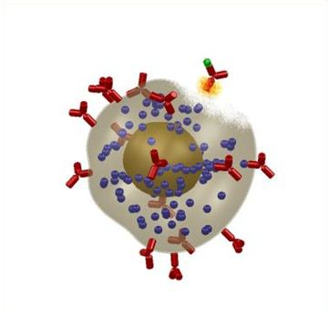
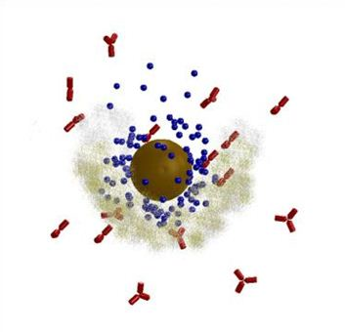
Acute-phase Response
The antigens from Nathan’s grandma’s cat bind to the mast cells on the mucosal surface of his airways
Nathan’s mast cells then release chemical mediators like histamine, leukotrienes, and prostaglandins
  Histamine is among the first mediators released during Nathan’s asthma attack
  Leukotrienes cause his bronchioles to constrict
  Nathan’s prostaglandins enhance histamine’s inflammatory effects (3)
(4)
(4)

Slide 7
Acute-phase Response
His chemical mediators are then guilty of penetrating his inflammatory cells
Once infiltrated, his inflammatory cells release other inflammatory mediators such as interleukin 4 (IL-4), interleukin 5 (IL-5), tumor necrosis factor (TNF), and cytokines
  IL-4 activates B cells and eosinophils
  IL-5 is responsible for eosinophil growth and development
  TNF exaggerates airway inflammation and activates inflammatory cells
  Cytokines are chemical messengers that affect other immune cells (3)

Slide 8
Asthma Check-Up!
Inflammatory cells are definitely important during an asthma attack but they are initiated in response to something else…try again!
Correct! In order for an asthma attack to be initiated, there has to be an allergen to trigger the inflammatory response.
Allergen
Chemical mediators are an important part of the inflammatory response but they aren’t the first step…try again!
Mast cells have an early role in an asthma attack but they’re not quite the first step…try again!
What is the first step in an asthma attack?
Mast
cells
Allergen
Inflammatory
cells
Chemical
mediators

Slide 9
Asthma Check-Up!
B cells are important in the inflammatory response but they aren’t directly activated by the allergen…try again!
Neutrophils are early responders in an inflammatory response, but there are other cells that respond directly to the allergen…try again!
Allergen
Eosinophils are indeed important cells in the inflammatory response, but they aren’t the first cells on scene…try again!
Correct! Mast cells are already presensitized from previous exposure to the same allergen and are the first line of defense in an asthma attack.
Mast cells
After a person is exposed to an allergen, what cells of the inflammatory response come into play next?
Mast
cells
B cells
Neutrophils
Eosinophils

Slide 10
Asthma Check-Up!
Antigen presenting cells are responsible for an important part of inflammation by presenting antigens to the immune system, but they are not released by mast cells…try again!
Allergen
Hormones play a vital role in many of the body’s functions, but they are not released by mast cells during an asthma attack…try again!
Correct! Chemical mediators such as histamine and prostaglandins are released by mast cells during an asthma attack.
T lymphocytes play a role in inflammation but they are cells of their own. They are not released by mast cells…try again!
Mast cells
As the next part of the inflammatory process in an asthma attack, what do mast cells release?
Chemical mediators
Antigen presenting cells
Hormones
T lymphocytes
Chemical mediators

Slide 11
Asthma Check-Up!
Neutrophils are one type of inflammatory cells that are directly impacted by chemical mediators…try again!
Endothelial cells are one type of inflammatory cells that are directly impacted by chemical mediators…try again!
Correct! Lymph nodes respond to inflammatory cells and are not directly infiltrated by chemical mediators.
Allergen
Platelets are part of the inflammatory process and are affected by chemical mediators…try again!
Chemical mediators, upon being released from mast cells, infiltrate inflammatory cells. These include all of the following except what?
Mast cells
Chemical mediators
Lymph
nodes
Endothelial
cells
Inflammatory cells
Neutrophils
Platelets

Slide 12
Asthma Check-Up!
Allergen
Histamine is actually one of the first mediators that is released during an inflammatory response. Since this is the fifth step in the asthmatic’s response, try again!
Prostaglandins do induce inflammation but they are not what IL-4, IL-5, and TNF are categorized under…try again!
Immunoglobulins are proteins that play an antibody role during the immune process…try again!
Correct! These mediators are released from inflammatory cells and beef up the asthmatic’s inflammatory process.
Mast cells
IL-4, IL-5, and tumor necrosis factor are types of _____ that are released by inflammatory cells.
Chemical mediators
Inflammatory mediators
Immunoglobulins
Inflammatory cells
Histamine
Prostaglandins
Inflammatory mediators

Slide 13
Late-phase Response
Nathan’s acute-phase response left off by releasing inflammatory mediators
During his late-phase response, those same inflammatory mediators will be released in response to continued exposure to his grandma’s cat
This ultimately leads to edema, injury of the epithelium, and impaired mucosal functioning (3)

Slide 14
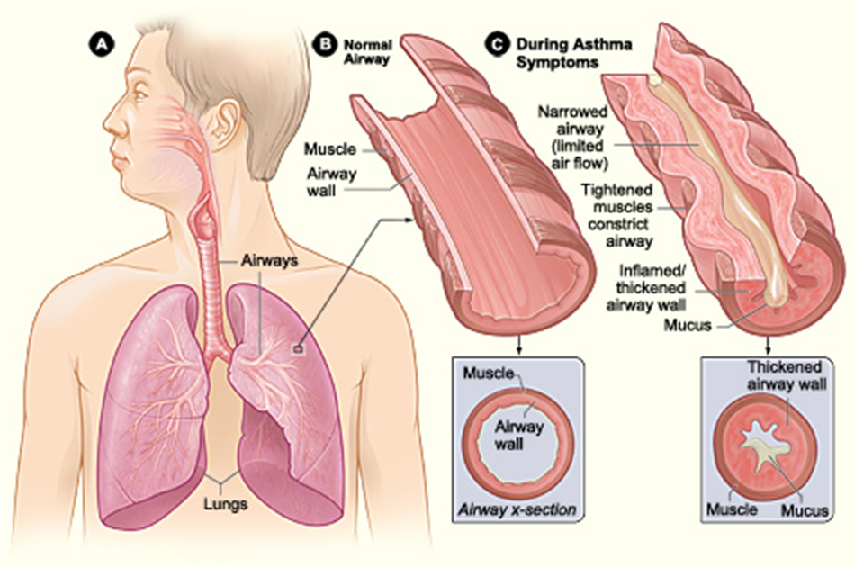
Exacerbation Manifestations
During his asthma attack, Nathan’s airways narrow, his muscles constrict, and his mucosal functioning is impaired. Air becomes
trapped in his alveoli, resulting in dyspnea, fatigue from using his accessory muscles, wheezing, an increased respiratory rate, and alteration in his ventilation and perfusion. (3)
(5)

Slide 15
Asthma Check-Up!
During Nathan’s asthma attack, his airways end up narrowing. Which of the following would not be a cause of airway narrowing during an asthma attack?
Edema of the bronchioles
Mucus plugging
Bronchospasm
Wheezing
Spasm of the bronchioles would be a cause of airway constriction and narrowing…try again!
Correct! Wheezing would be a manifestation of airway narrowing, not a cause.
If the airways are full of mucus that cannot easily be removed, that would mean that it would indeed be a cause of airway narrowing…try again!
If edema of the bronchioles is present, that would mean that the airways would be narrow...try again!

Slide 16
Asthma Check-Up!
Due to Nathan’s progressive airway obstruction during his asthma attack, you can expect all of the following to occur except _____.
Decrease in residual volume
Prolonged expiration
Alteration in perfusion and ventilation
Trapped air in the alveoli
Correct! When airway obstruction is present, there is going to be an increase in residual volume, meaning an increase in the amount of air left in the lungs after exhalation.
Airway obstruction means that air has a hard time coming back out, meaning that air would in fact be trapped in the alveoli…try again!
Expiration will in fact be prolonged due to airway obstruction because Nathan will be trying to push the extra air out from his lungs…try again!
Airway obstruction causes an alteration in perfusion and ventilation due to the decreased airflow in and out…try again!

Slide 17
Asthma Check-Up!
During Nathan’s asthma attack he exhibits classic signs and symptoms including prolonged expiration, dyspnea, fatigue, wheezing, use of his accessory muscles, and increased respiratory rate. If Nathan’s wheezing would stop but the rest of his manifestations would remain, would this be a good thing or a bad thing for Nathan?
A good thing
A bad thing
Correct! If Nathan’s wheezing stops that means that his airflow is now severely decreased and respiratory failure is setting in.
If Nathan’s wheezing stops, that means that his airflow is now severely decreased…not a good thing!

Slide 18
Case Study Continued…
Nathan’s mother grabbed his albuterol inhaler out of her purse and gave it to Nathan to use. Being a nurse herself, Nathan’s mother was readily aware of the fact that albuterol, a beta-2 adrenergic agonist, acts by relaxing the bronchial smooth muscle. Nathan’s signs and symptoms slowly began to improve and his respiratory status returned to normal. Nathan now knows that one of his asthmatic triggers is his grandma’s cat, and he needs to avoid it in the future to prevent an asthma attack from occurring.

Slide 19
References
1 - Summary Health Statistics for U.S. Adults: National Health Interview Survey, 2010, table 3.
2 - Summary Health Statistics for U.S. Children: National Health Interview Survey, 2010, table 1.
3 - Porth, C. M. & Matfin, G. (2008). Pathophysiology: Concepts of altered health. Philadelphia: Lippincott, Williams & Wilkins.
4 - Pictures used with permission from http://www.chirosmedical.sk /EN/produkty_dezinfekcia2_en.html.
5 - Picture used with permission from National Heart Lung and Blood Institute.

